Slide 1

Software Testing
Presented By
Gogu.Edukondalu

Slide 2
Contents
What is Testing? Importance of testing.
Why does software have defects?
SDLC (Software Development Life Cycle)
STLC(Software Testing Life Cycle)
Testing Levels
Testing Types
SDLC Models
Conclusion

Slide 3

Importance of testing.
What is Testing?
Software testing is a process of executing a program
or an application with the intent of finding the errors.
As we all are human beings and human beings commit errors in any process , some of the errors do not impact and can be ignored, however some errors are so severe that they can break the whole system or software
China Airlines Airbus A300 crashed due to a software bug on April 26, 1994, and kills 264 people.

Slide 4
Why does software have defects?
Incorrect requirements
Wrong design
Poor coding
Complex business logic
Complex technology
Work pressure
Frequently changing requirements

Slide 5
SDLC(Software Development Life Cycle)
Gathering Requirements
Planning
Designing
Coding
Testing
Delivery & Maintenance

Slide 6
Testing Levels
Unit Testing
Integration Testing
System Testing
User Acceptance Testing
Alpha Testing
Beta Testing

Slide 7
Testing Types
Functional Testing
Non - Functional testing
Sanity Test
Performance Testing
Smoke Test
Reliable Testing
Black Box testing
Usability Testing
White Box Testing
Accessibility Testing
Gray Box Testing
Compatibility Testing
Re -Testing
Security Testing
Regression Testing

Slide 8
SDLC Models
Waterfall Model
Incremental Model
V-V Model
Big Bang model
Agile Model

Slide 9
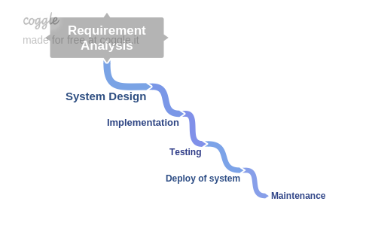
SDLC Models
Waterfall Model

Slide 10
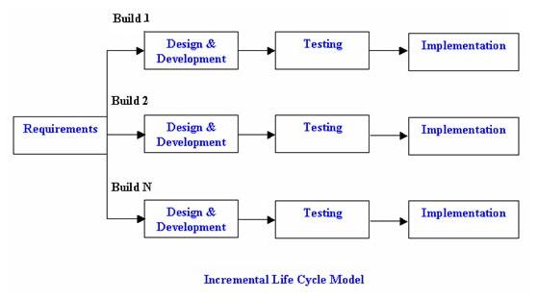
SDLC Models
Incremental Model

Slide 11
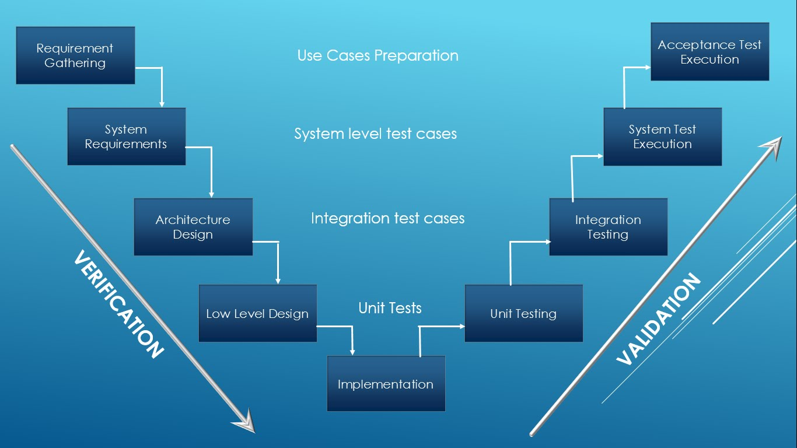
SDLC Models
V-V Model

Slide 12
SDLC Models
Big Bang model
The Big Bang model is SDLC model where there is no specific process followed. The development just starts with the required money and efforts as the input, and the output is the software developed which may or may not be as per customer requirement.
Big Bang Model is SDLC model where there is no formal development followed and very little planning is required. Even the customer is not sure about what exactly he wants and the requirements are implemented on the fly without much analysis.

Slide 13
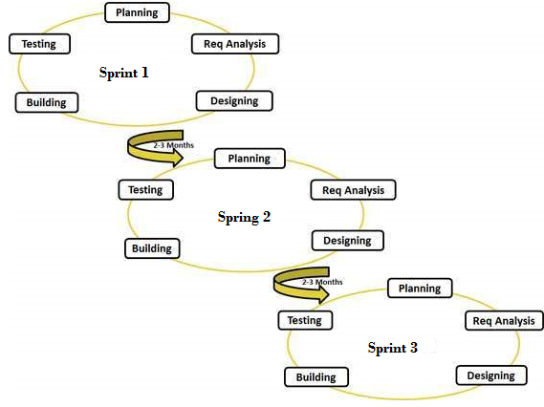
SDLC Models
Agile Model

Slide 14
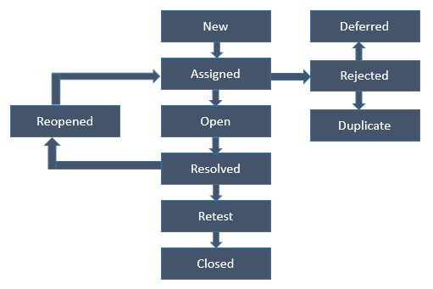
Bug life cycle

Slide 15


